Slide 1
Machine Learning DASC 522
Neural Network Foundations & Processes
Dr. Torrey Wagner

Slide 2
Overview
Big Picture
Background & Structure
Perceptrons
Perceptron Learning
Artificial Neural Networks (ANN or NN)
NN Learning
Optimization

Slide 3
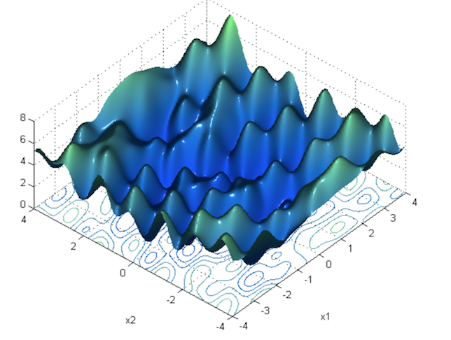
Optimization Overview
https://towardsdatascience.com/neural-network-optimization-7ca72d4db3e0

Slide 4
Solution Space
Eigenvalues: all positive all negative some positive, some neg
We hope for global minimum
Could be local minimum
High dimensional problems are more likely to yield mostly saddle points
Due to random matrix theory
Slide from Dr. Brett Borghetti, AFIT/ENG CSCE 823 Advanced Machine Learning, 2019SU

Slide 5
Optimization Techniques
Goal is to find weights to minimize error
Many ways to do this
Exhaustive search
Random search (e.g. genetic algorithms)
Analytical solution (e.g. linear regression)
Model-based search (e.g. maximum likelihood)
Gradient-based search (main method for ANN)
Slide from Dr. Brett Borghetti, AFIT/ENG CSCE 823 Advanced Machine Learning, 2019SU

Slide 6
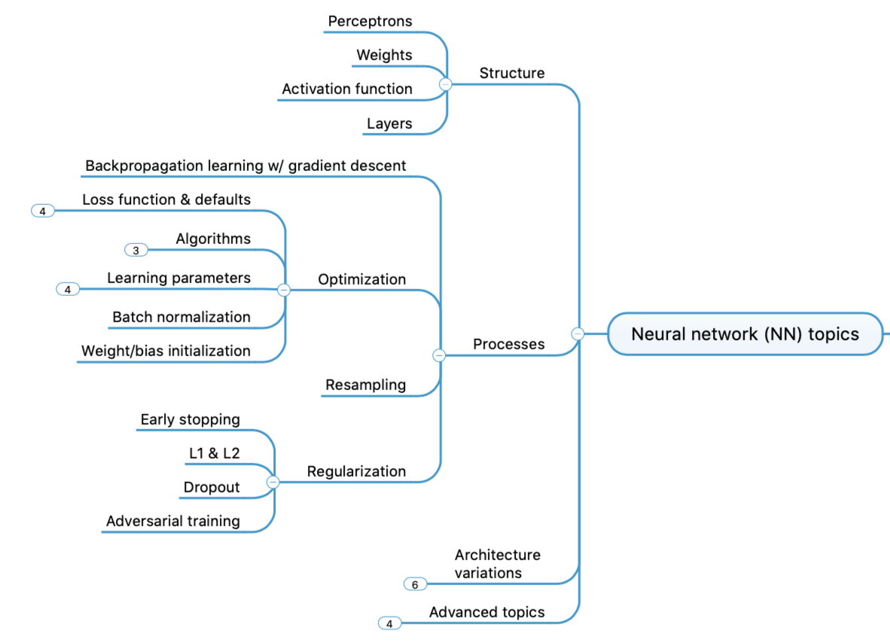
Concept Map - NN

Slide 7
https://towardsdatascience.com/a-i-enhanced-molecular-discovery-and-optimization-9434f3f8a593

Slide 8
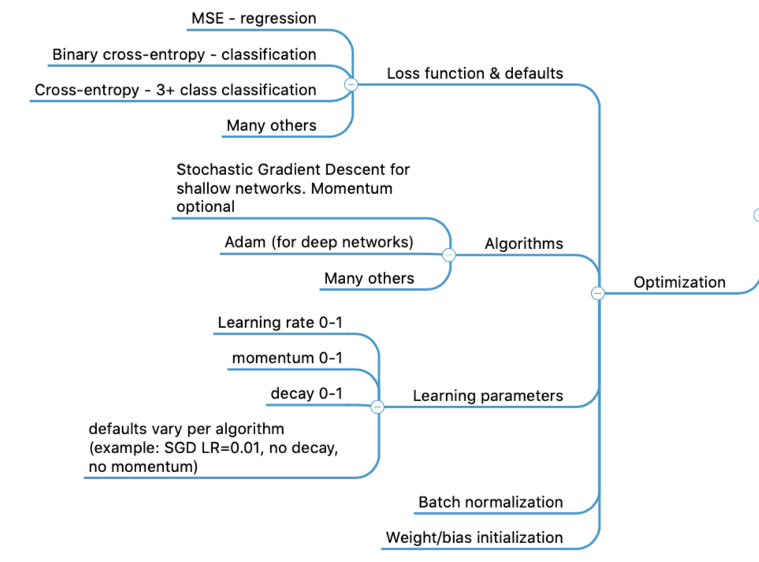
Concept Map - NN

Slide 9
Optimization
Concepts in order of importance
Loss functions
Optimizer algorithm
Learning parameters
Batch normalization
Weight / bias initialization

Slide 10
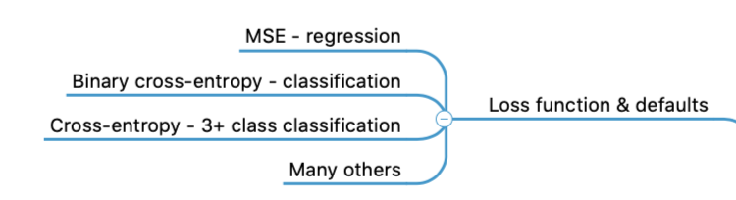
Optimization
Concepts in order of importance
Loss functions
Optimizer algorithm
Learning parameters
Batch normalization
Weight / bias initialization

Slide 11
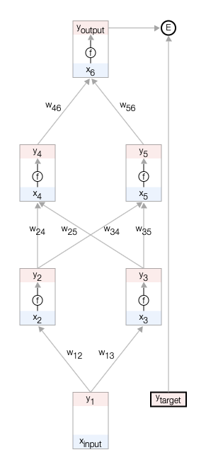
Loss Function
https://keras.io/api/losses/
https://developers-dot-devsite-v2-prod.appspot.com/machine-learning/crash-course/backprop-scroll?authuser=1

Slide 12
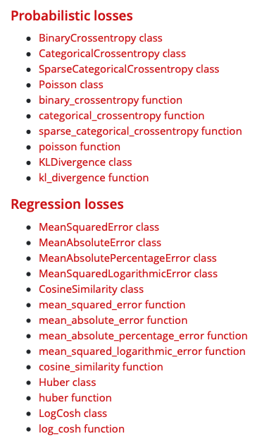
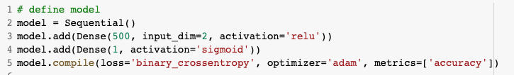
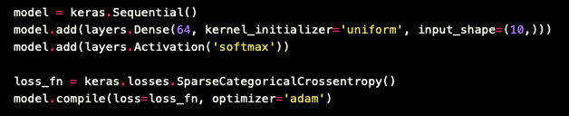
Loss Function
https://keras.io/api/losses/

Slide 13
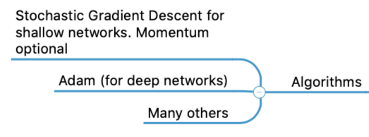
Optimization
Concepts in order of importance
Loss functions
Optimizer algorithm
Learning parameters
Batch normalization
Weight / bias initialization

Slide 14
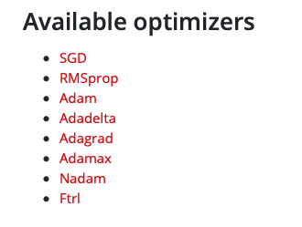
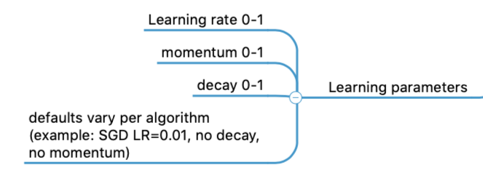
Keras Optimizers
https://keras.io/api/optimizer

Slide 15
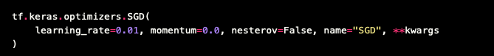
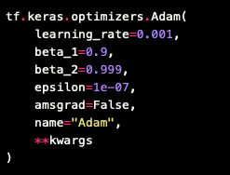
Keras Optimizers
https://keras.io/api/optimizers/adam/

Slide 16
Discussion of Techniques
https://www.kaggle.com/residentmario/keras-optimizers

Slide 17
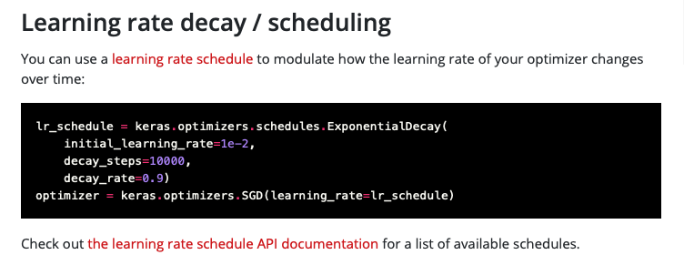
Keras Learning Parameters
Typically you won’t adjust these manually – they are a part of the algorithm that you select
https://keras.io/api/optimizer

Slide 18
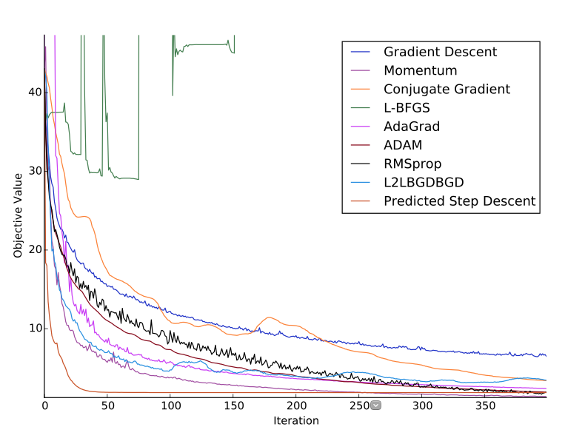
Comparison of Optimizer Functions
Li & Malik, Learning to Optimize Neural Nets, UC Berkeley

Slide 19
Animation of Techniques
https://imgur.com/a/Hqolp

Slide 20
Optimization
Concepts in order of importance
Loss functions
Optimizer algorithm
Learning parameters
Batch normalization
Weight / bias initialization

Slide 21
Batch Normalization
In backprop, gradients are computed per layer, working backwards from output toward input
Deep networks may have trouble propagating blame a long way back because a layer make take “more than it’s share of the blame”
May unintentionally shift mean or variance of a layer
Key idea: replace activations at a layer with z-scaled activations at a layer during training
Prevents the layer from arbitrarily shifting mean or variance when computing weight updates
Slide from Dr. Brett Borghetti, AFIT/ENG CSCE 823 Advanced Machine Learning, 2019SU

Slide 22
Batch Normalization
MNIST Image Recognition Dataset
https://www.dlology.com/blog/one-simple-trick-to-train-keras-model-faster-with-batch-normalization/

Slide 23
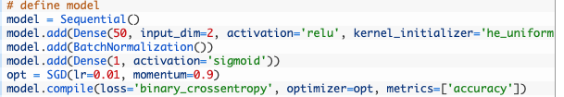
Batch Normalization
https://machinelearningmastery.com/how-to-accelerate-learning-of-deep-neural-networks-with-batch-normalization/

Slide 24
Batch Normalization
https://machinelearningmastery.com/how-to-accelerate-learning-of-deep-neural-networks-with-batch-normalization/

Slide 25
Optimization
Concepts in order of importance
Loss functions
Optimizer algorithm
Learning parameters
Batch normalization
Weight / bias initialization

Slide 26
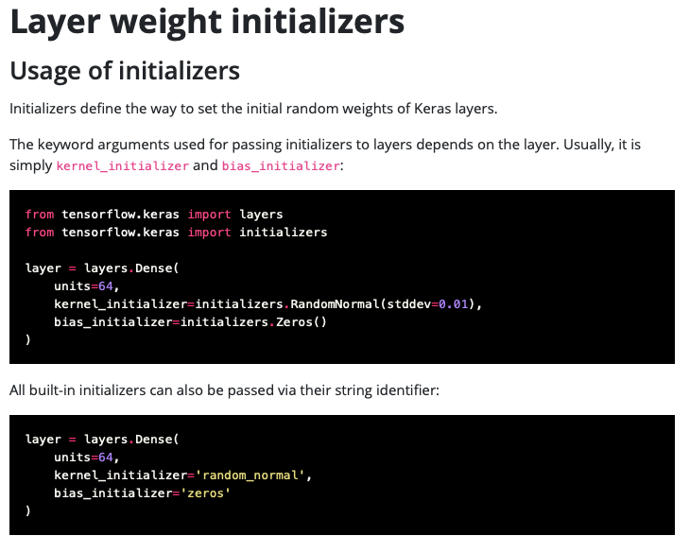
Keras Weight & Bias Initialization
Available initializers
RandomNormal
RandomUniform
TruncatedNormal
Zeros
Ones
Constant
4 others
https://keras.io/api/layers/initializers/

Slide 27
Python Demonstration

Slide 28
Summary
For your problem
Select appropriate loss function
Select appropriate optimization algorithm
Within that optimizer, default learning parameters will normally work well
Perform a sweep if you have reason to believe it will help
Leave batch normalization & weight/bias initialization to their defaults

Slide 29
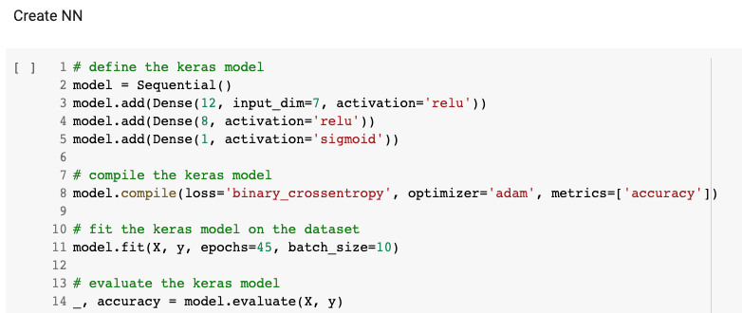
Just for fun…

